Slide 1


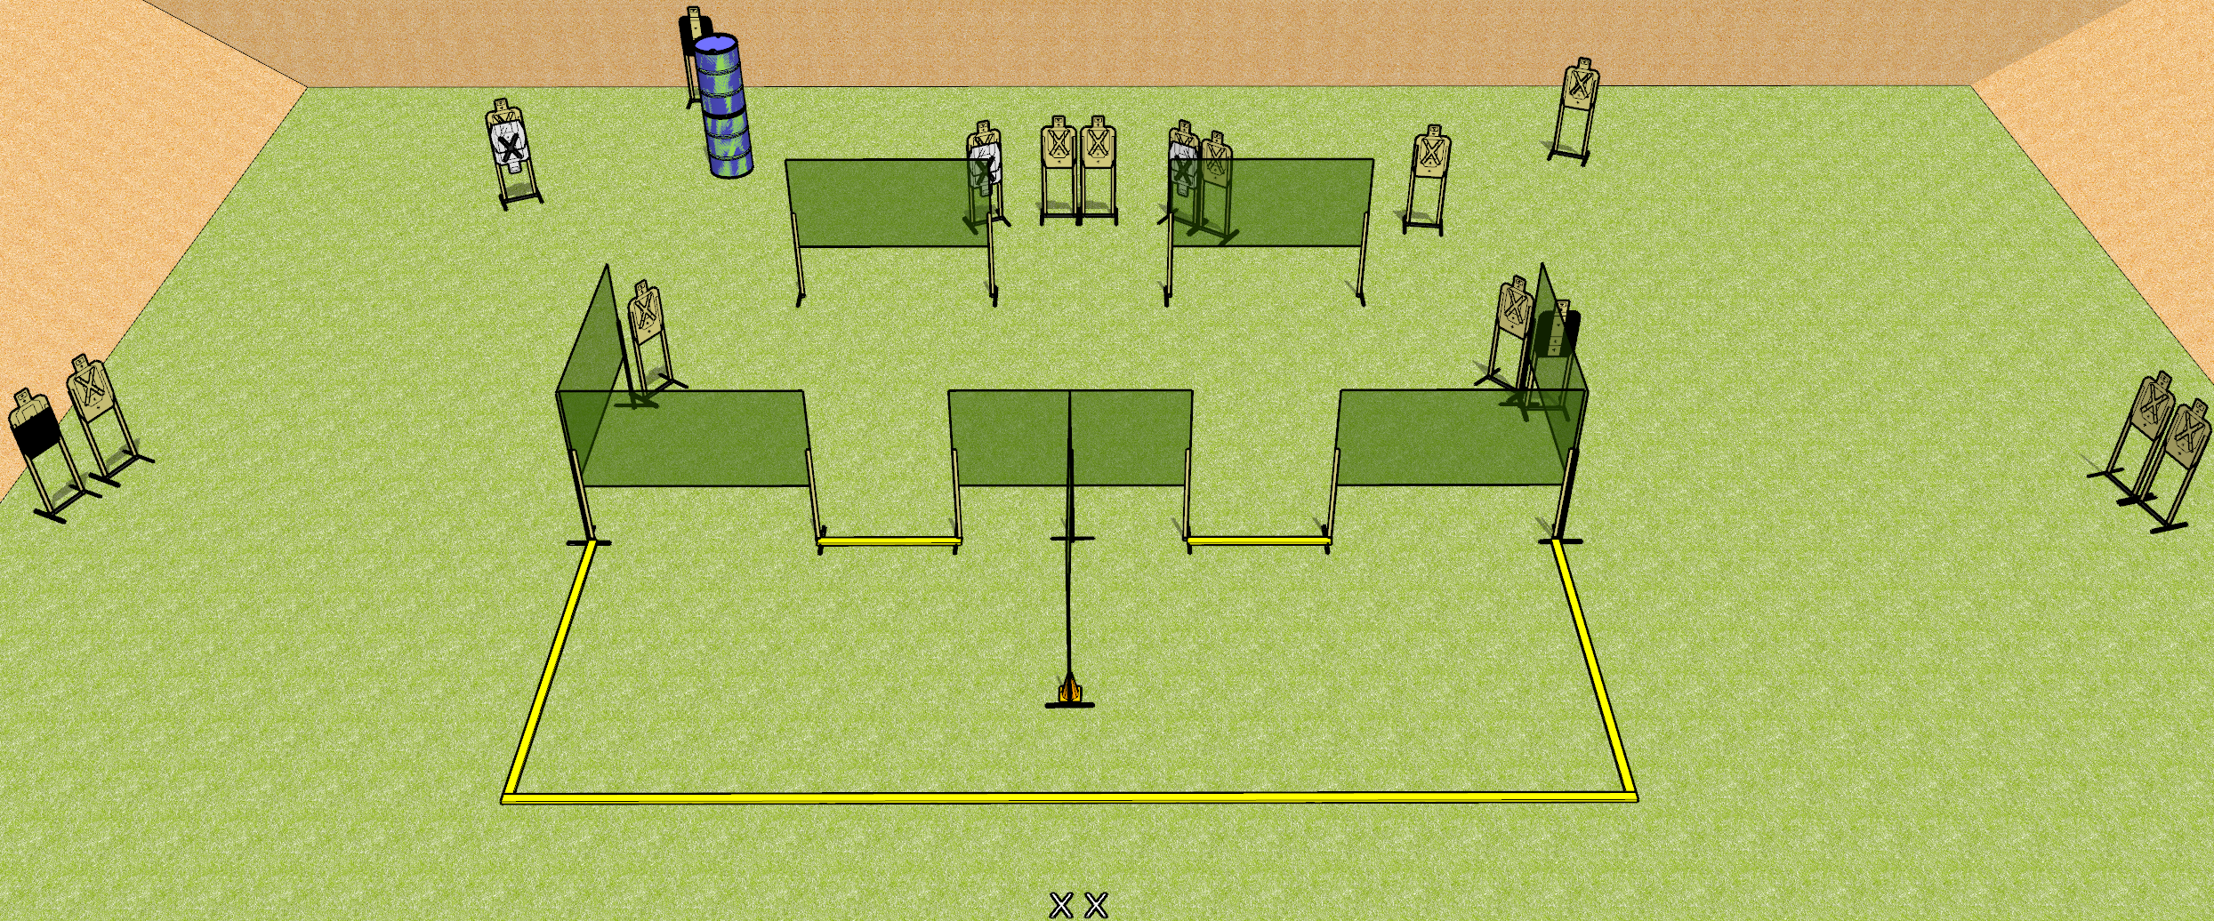
 | Dothan Gun Club – USPSA Match Ode to Florida State Course Designer : Drew Coleman
START POSITION : Standing with both feet on X’s, wrists below belt
GUN READY CONDITION : Pistol loaded and holstered. PCC loaded, held with both hands, shouldered, safety on, pointed at orange cone. |  | SCORING: Comstock, 32 rounds TARGETS: 16 paper, 0 Steel SCORED HITS: Best 2 on paper, steel until down START-STOP: Audible, last shot RULES:
STAGE PROCEDURE: Engage targets as they become available from within the fault lines.

Slide 2
Ode to Florida State
Written Stage Briefing
Ode to Florida State is a 32 round, 160 point, Comstock field course. There are sixteen USPSA targets. The best two hits on paper will score. The start signal is audible.
Handgun start position is standing with both feet on X’s, wrists below belt. Handgun is loaded and holstered.
PCC start position is standing with both feet on X’s, muzzle pointed at orange cone. Loaded carbine is held with both hands, shouldered, safety on.
On start signal, engage targets as they become available from within the fault lines.

